Slide 1
SC-200T00A Microsoft Security Operations Analyst
Author name Date

Slide 2
Module 6: Connect logs to Azure Sentinel

Slide 3
Module agenda
Connect data to Azure Sentinel using data connectors
Connect Microsoft services to Azure Sentinel
Connect Microsoft 365 Defender to Azure Sentinel
Connect Windows hosts to Azure Sentinel
Connect Common Event Format logs to Azure Sentinel
Connect syslog data sources to Azure Sentinel
Connect threat indicators to Azure Sentinel

Slide 4
Lesson 1: Connect data to Azure Sentinel using data connectors

Slide 5
Lesson introduction
After this lesson, you will be able to:
Explain the use of data connectors in Azure Sentinel
Describe the Azure Sentinel data connector providers
Explain the Common Event Format and Syslog connector differences in Azure Sentinel

Slide 6
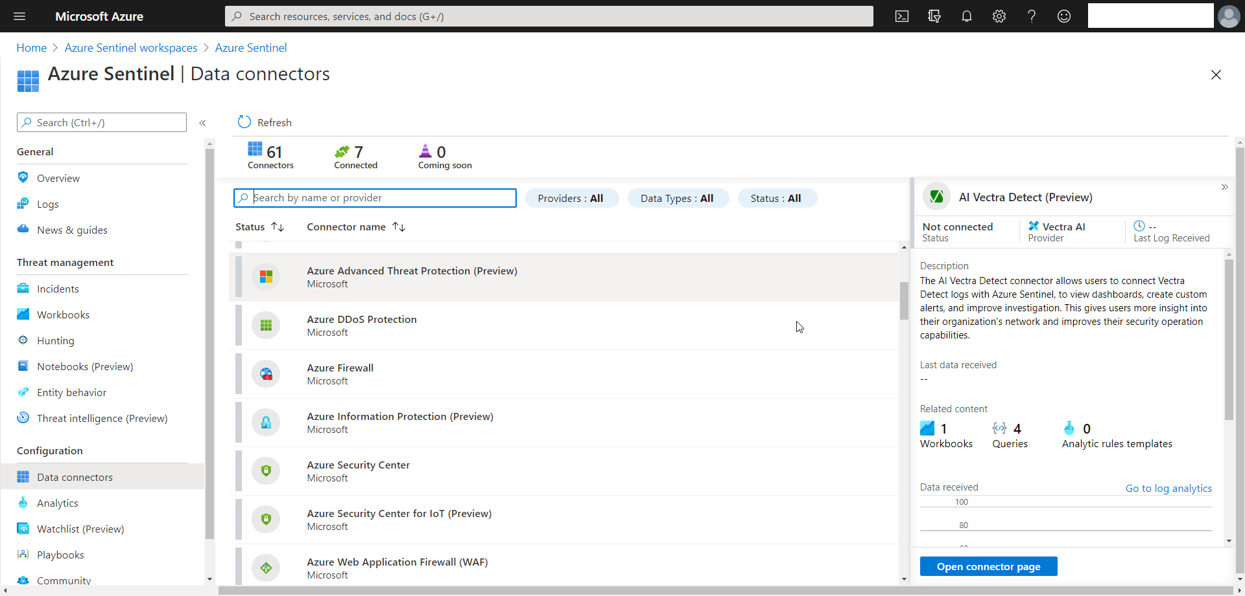
Ingest log data with data connectors
To collect log data, you need to connect your data sources with Azure Sentinel Connectors.

Slide 7
Understand data connector providers
Microsoft 365 Defender and related Defender services
Microsoft 365 and Azure Services
Vendor connectors
Custom connectors using the Log Analytics API
Logstash plugin
Common Event Format (CEF) and Syslog connector

Slide 8
View connected hosts
The Data Connector page shows the connectors that are connected. The number of Windows and Linux hosts connected with the Log Analytics agent is available in the Log Analytics workspace.
You can view the connected hosts in the Log Analytics Workspace Agents Management page.
Notes:
Instructor demonstrations:
Data Connector list
Connector page
Agents Management page

Slide 9
Section break

Slide 10
Lesson 2: Connect Microsoft services to Azure Sentinel

Slide 11
Lesson introduction
After this lesson, you will be able to:
Connect Microsoft service connectors
Explain how connectors auto-create incidents in Azure Sentinel

Slide 12
Plan for Microsoft services connectors
Prerequisites
Configuration
Create incidents

Slide 13
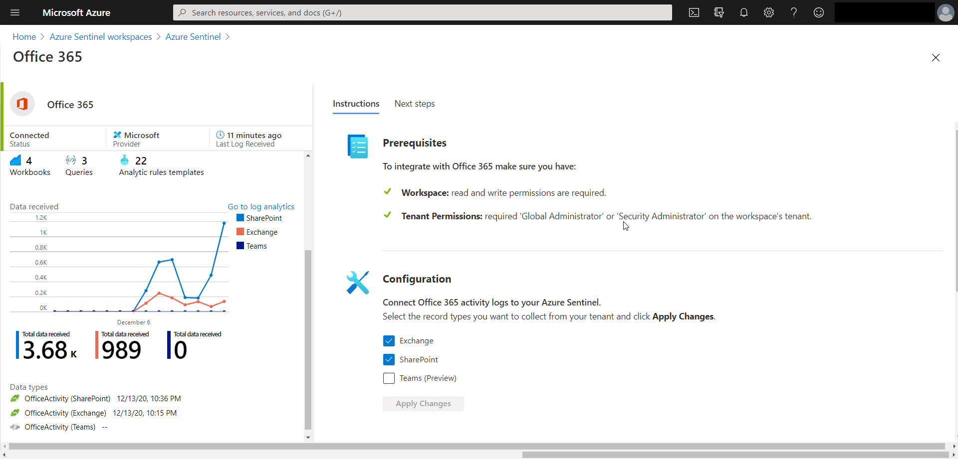
Connect the Microsoft Office 365 connector
The Office 365 activity log connector provides insight into ongoing user activities. You will get details of operations such as file downloads, access requests sent, changes to group events, set-mailbox, and details of the user who performed the actions.

Slide 14
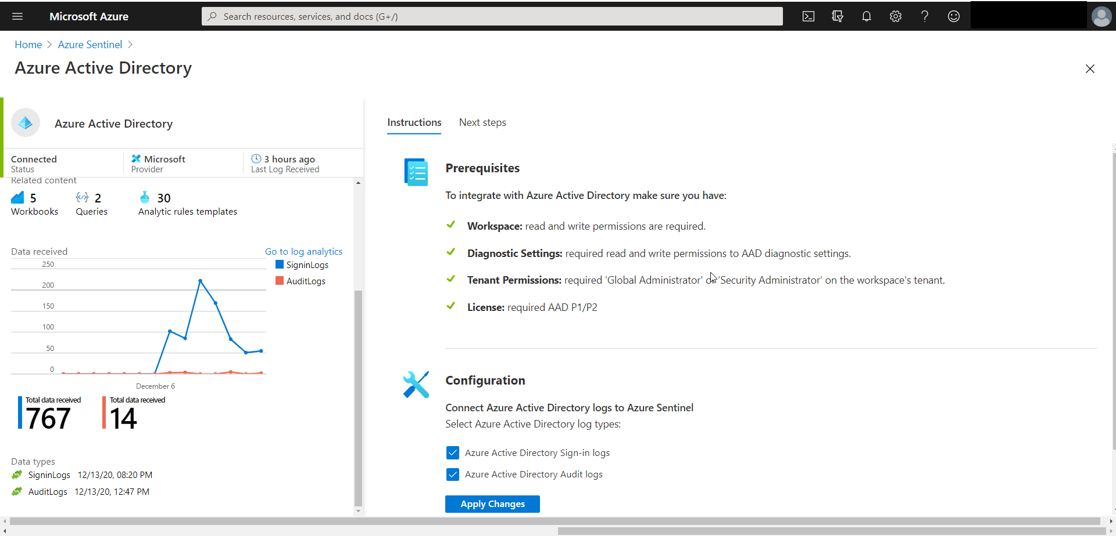
Connect the Azure Active Directory connector
Gain insights into Azure Active Directory by connecting Audit and Sign in logs to Azure Sentinel to gather insights around Azure Active Directory scenarios.

Slide 15
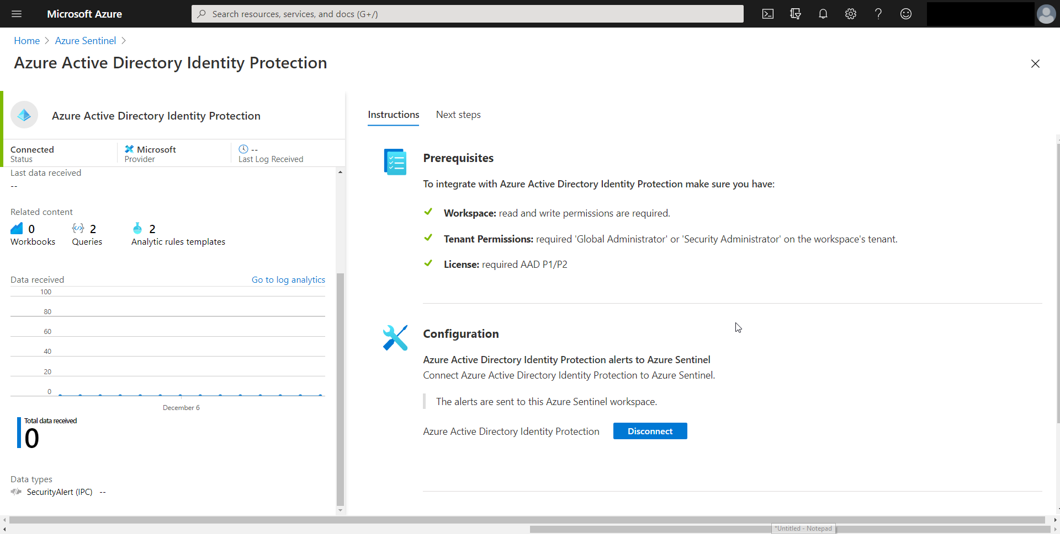
Connect the Azure Active Directory Identity Protection connector
Azure Active Directory Identity Protection provides a consolidated view of at-risk users, risk events, and vulnerabilities, with the ability to remediate risk immediately and set policies to auto remediate future events.
Notes:
Instructor demonstration:
Office 365 connector
Azure Active Directory connector
Azure Active Directory Identity Protection connector

Slide 16
Section break

Slide 17
Lesson 3: Connect Microsoft 365 Defender to Azure Sentinel

Slide 18
Lesson introduction
After this lesson, you will be able to:
Activate the Microsoft 365 Defender connector in Azure Sentinel
Activate the Microsoft Defender for Endpoint connector in Azure Sentinel
Activate the Microsoft Defender for Office 365 connector in Azure Sentinel

Slide 19
Plan for Microsoft 365 Defender connectors
Microsoft Defender for Endpoint
Microsoft Defender for Office 365
Microsoft Defender for Identity
Microsoft Cloud App Security
Notes:
Explain that the Defender for connectors only send alert data that can then generate incidents

Slide 20
Connect alerts from Microsoft Defender for Office 365
With Microsoft Defender for Office 365 alerts, you can incorporate information about email-based and URL-based threats into your broader risk analysis and build response scenarios accordingly.

Slide 21
Connect alerts from Microsoft Defender for Endpoint
Fetch alerts generated in Microsoft Defender for Endpoint so that you can effectively analyze security events.

Slide 22
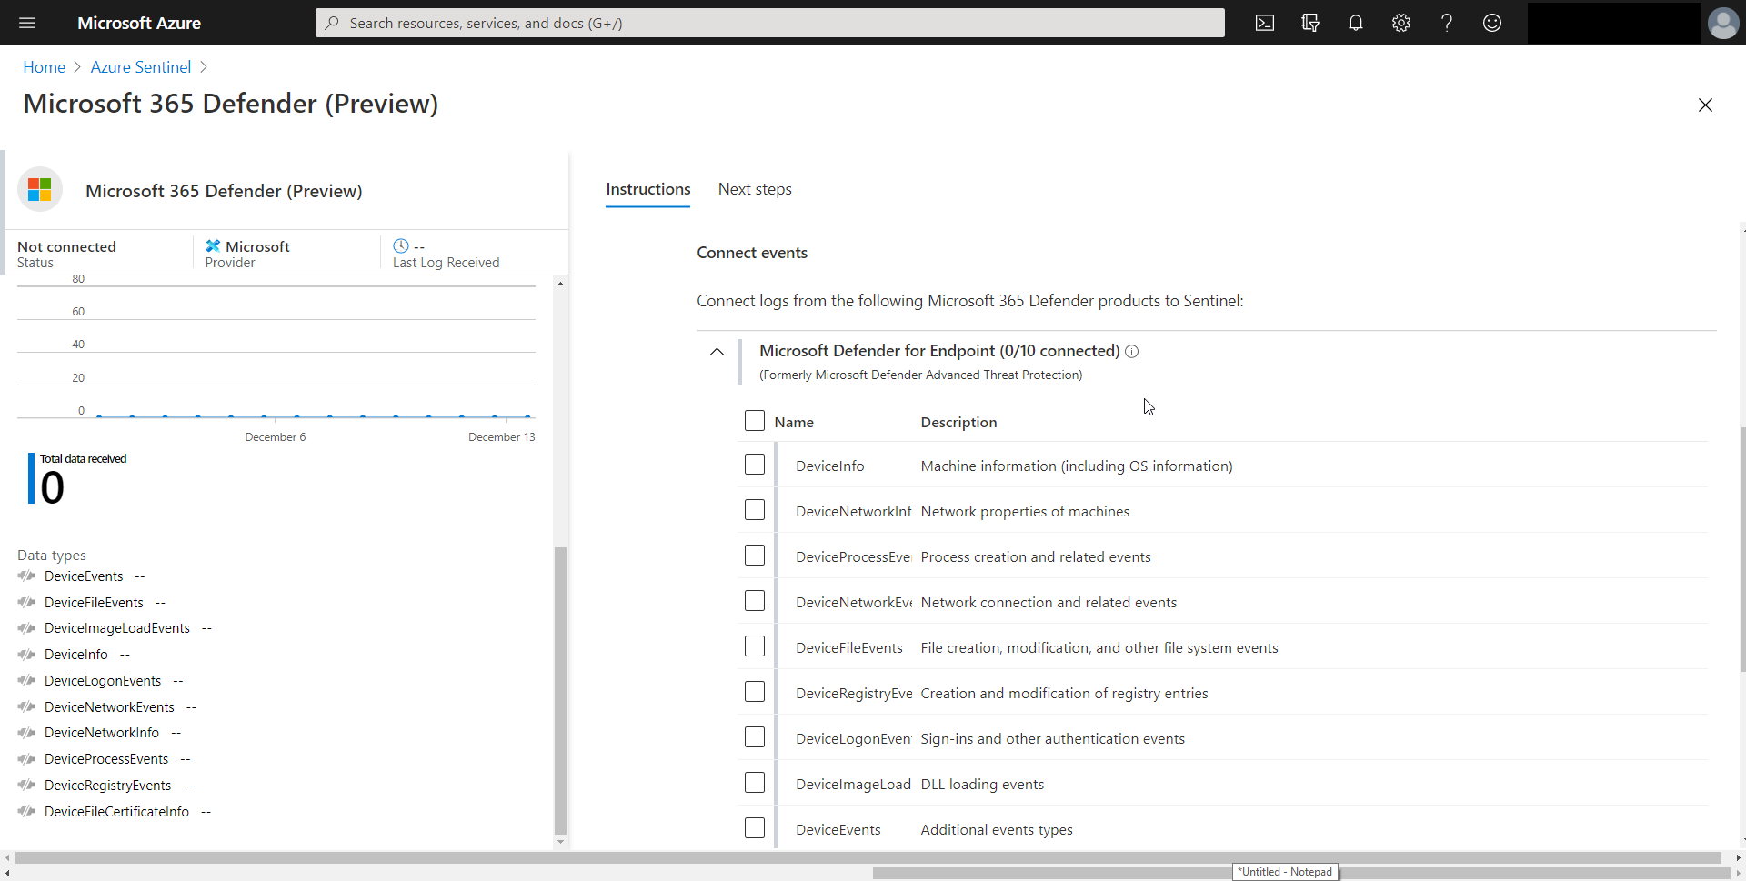
Connect the Microsoft 365 Defender connector
The Microsoft 365 Defender connector lets you stream advanced hunting logs - a type of raw event data - from Microsoft 365 Defender.
Notes:
Instructor demonstration:
Defender for Office 365 connector
Defender for Endpoint connector
Microsoft 365 Defender connector

Slide 23
Section break

Slide 24
Lesson 4: Connect Windows hosts to Azure Sentinel

Slide 25
Lesson introduction
After this lesson, you will be able to:
Connect Azure Windows Virtual Machines to Azure Sentinel
Connect non-Azure Windows hosts to Azure Sentinel
Configure Log Analytics agent to collect Sysmon events

Slide 26
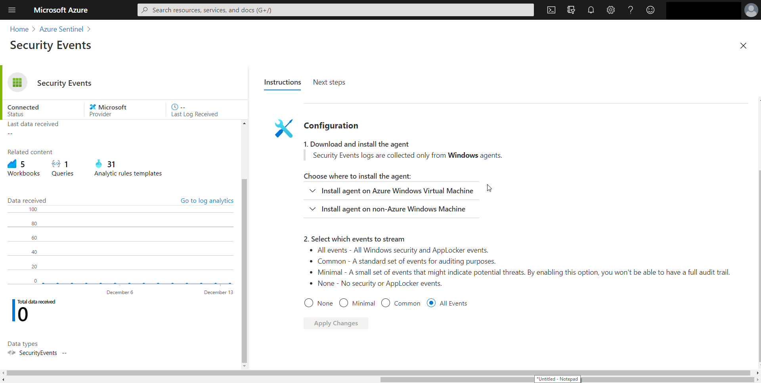
Plan for Windows hosts security events connector
The Security Events connector lets you stream all security events from your Windows systems (servers and workstations, physical and virtual) to your Azure Sentinel workspace.
Notes:
Point out the events to stream.
Connecting Azure windows VM is just a process of selecting connect.
FYI – the text description after you choose where to install agent is backwards. The links still take you to the proper place

Slide 27
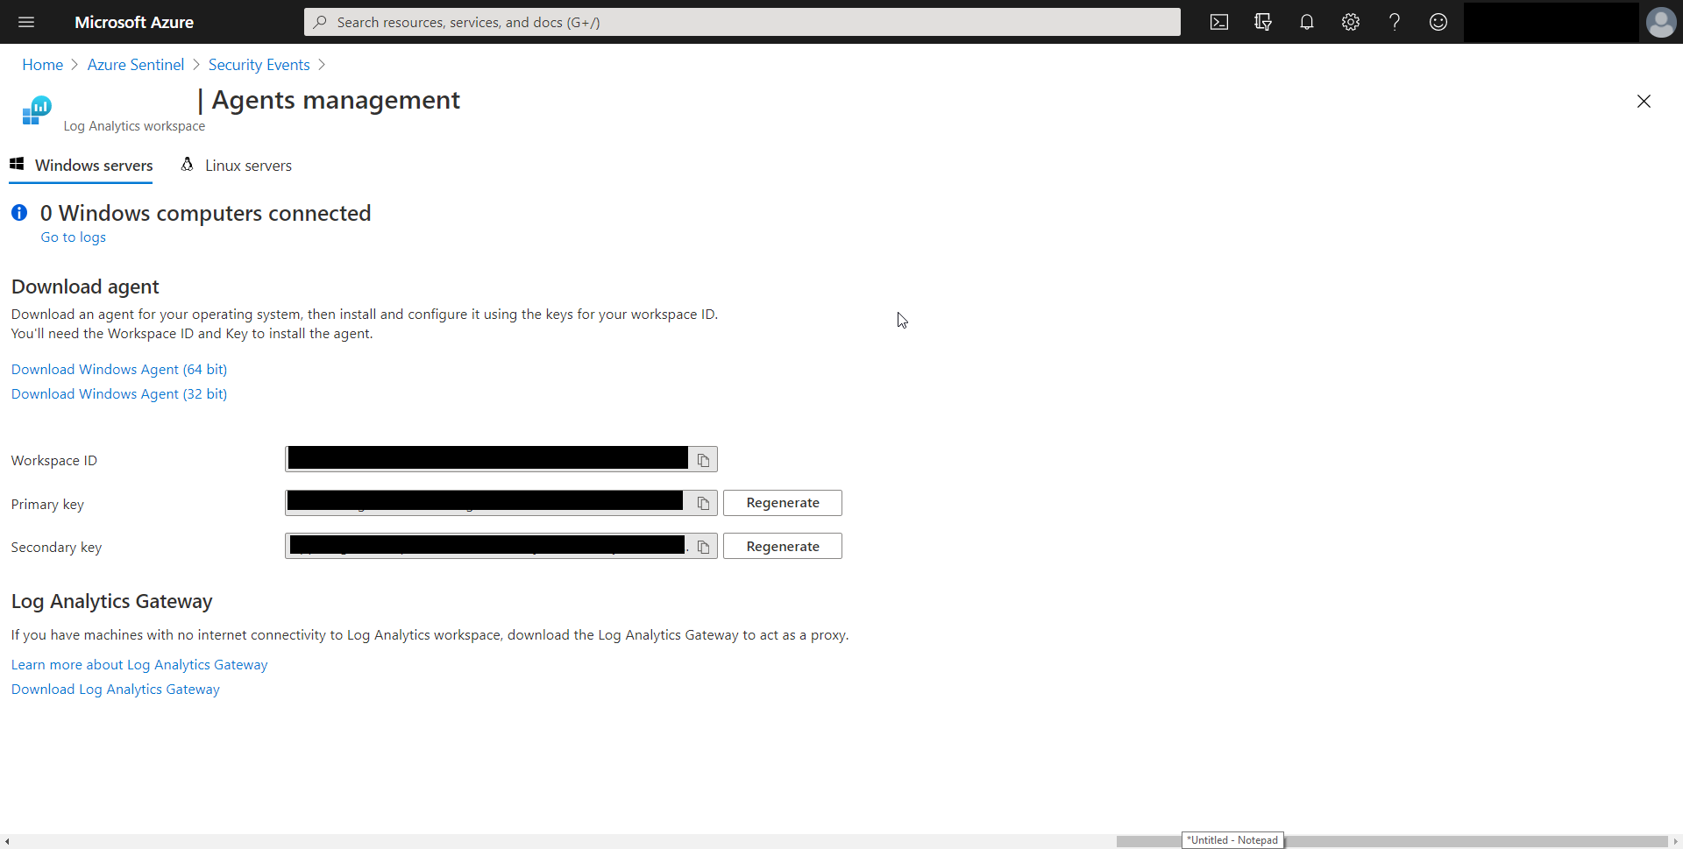
Connect non-Azure Windows Machines
When connecting non-Azure Windows hosts, you need to manually install the client agent.
Notes:
More steps involved for non-azure. Need to manually install the agent.

Slide 28
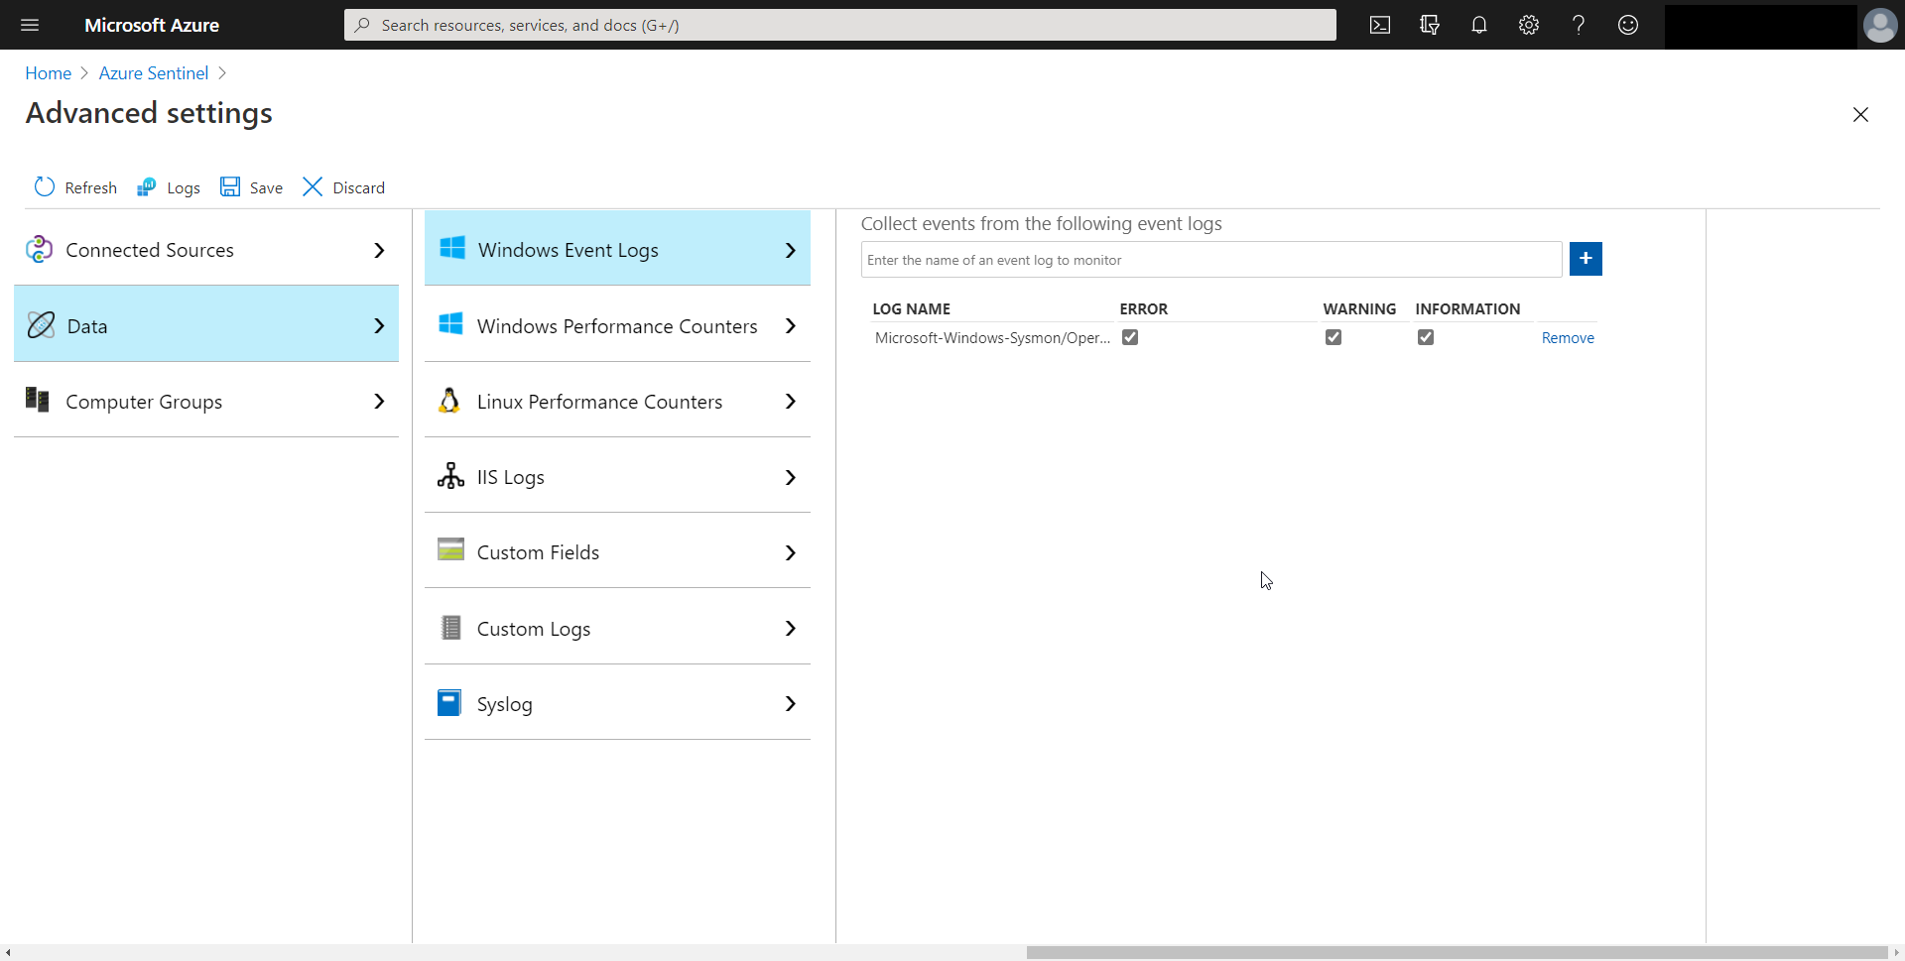
Collect Sysmon event logs
The Microsoft-Windows-Sysmon/Operational entry is required in the Windows Event Logs.
Notes:
System Monitor (Sysmon) is a Windows system service, and device driver that remains resident across system reboots to monitor and log system activity to the Windows event log once installed on a system. It provides detailed information about process creations, network connections, and changes to file creation time. By collecting the events it generates using Windows Event Collection or SIEM agents and then analyzing them, you can identify malicious or anomalous activity and understand how intruders and malware operate on your network.
This is performed in the Log Analytics workspace. There is a new direct UI location.
Instructor demonstration:
Security Events connector
Connect an Azure Windows VM
Connect a non-Azure Windows Host
Configure Sysmon collection

Slide 29
Section break

Slide 30
Lesson 5: Connect Common Event Format logs to Azure Sentinel

Slide 31
Lesson introduction
After this lesson, you will be able to:
Explain the Common Event Format connector deployment options in Azure Sentinel
Run the deployment script for the Common Event Format connector

Slide 32
Plan for Common Event Format (CEF) connector
Deploys a Syslog Forwarder server to support the communication between the appliance and Azure Sentinel.
The server consists of a dedicated Linux machine with the Log Analytics agent for Linux installed.
Many of the Azure Sentinel Data Connectors that are vendor-specific utilize the CEF Connector.
Deployment options include Azure and On-premise based.
CEF is recommended over the Syslog Connector because CEF provides parsed message data

Slide 33
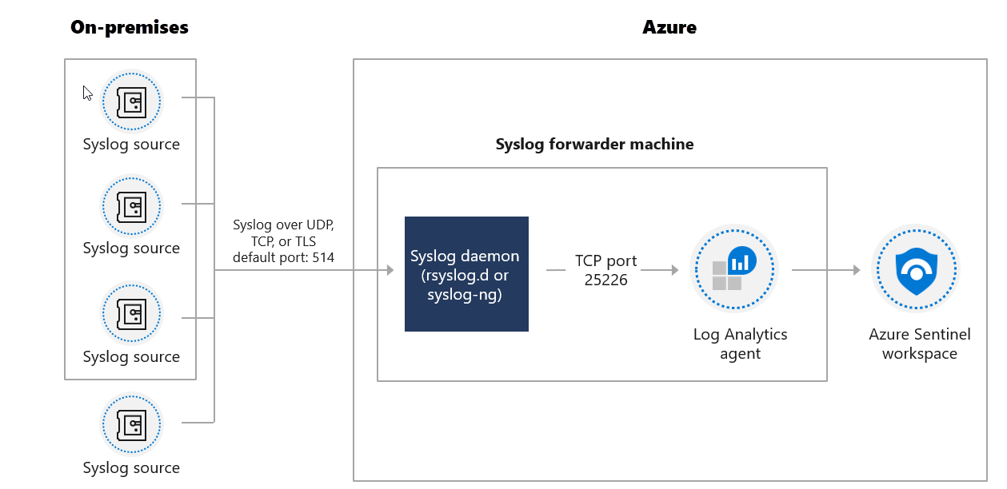
CEF Azure VM Architecture
The following diagram displays the setup in the case of a Linux VM in Azure. The on-premises Syslog sources send securely send events to an Azure Linux VM. The Linux VM with the Log Analytics agent installed then forwards the logs to the Azure Sentinel workspace.
Notes:
Optional slide that supports the CEF connector concept.

Slide 34
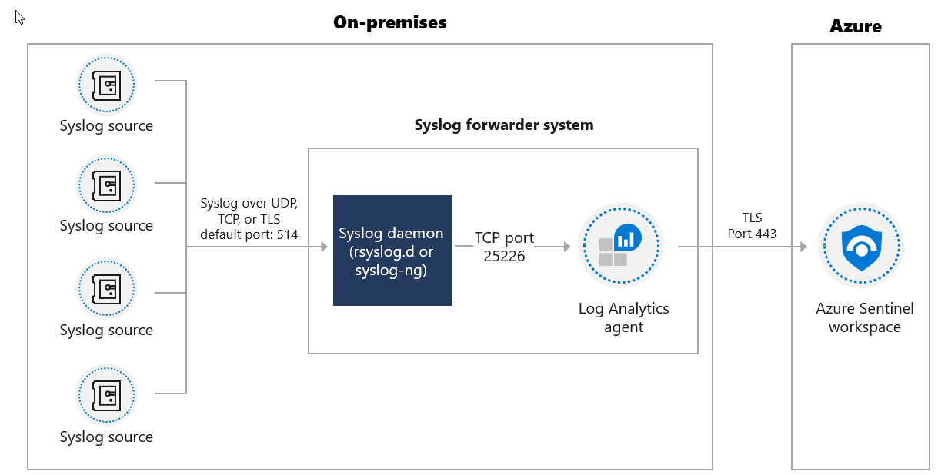
CEF on-premise Architecture
The following diagram displays the setup if you use a VM in another cloud or an on-premises machine. The on-premises Syslog sources send securely send events to a Linux VM. The Linux VM with the Log Analytics agent installed then securely forwards the logs to the Azure Sentinel workspace.
Notes:
Optional slide that supports the CEF connector concept.

Slide 35
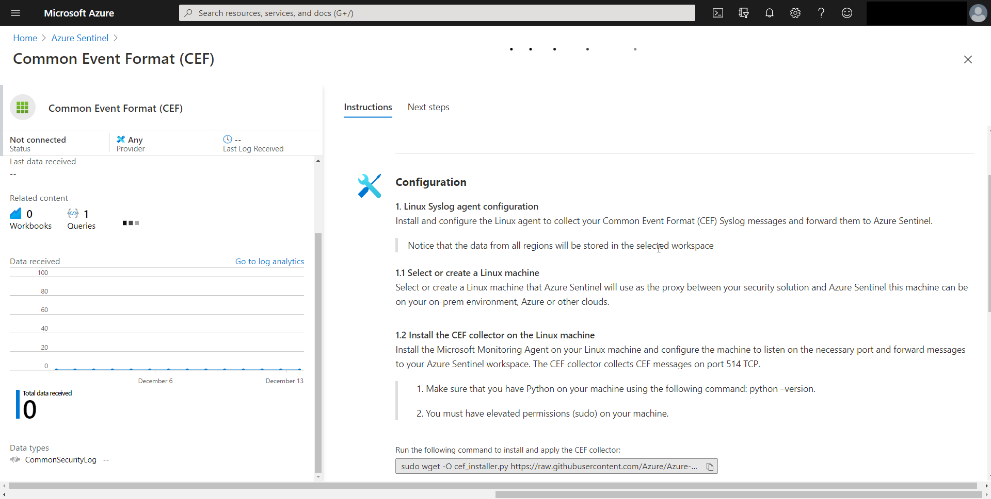
Connect your external solution using the CEF connector
Using the link provided on the connector page, you will run a script on the designated machine.
Notes:
You need to designate and configure a Linux machine to forward the logs from your security solution to your Azure Sentinel workspace. This machine can be physical or virtual in your on-premises environment, an Azure VM, or a VM in another cloud. Using the link provided, you will run a script on the designated machine that performs the following tasks:
Installs the Log Analytics agent for Linux (also known as the OMS agent) and configures it for the following purposes:
listening for CEF messages from the built-in Linux Syslog daemon on TCP port 25226
sending the messages securely over TLS to your Azure Sentinel workspace, where they are parsed and enriched
Configures the built-in Linux Syslog daemon (rsyslog.d/syslog-ng) for the following purposes:
listening for Syslog messages from your security solutions on TCP port 514
forwarding only the messages it identifies as CEF to the Log Analytics agent on localhost using TCP port 25226
Instructor demonstration:
Install the CEF connector

Slide 36
Section break

Slide 37
Lesson 6: Connect syslog data sources to Azure Sentinel

Slide 38
Lesson introduction
After this lesson, you will be able to:
Describe the Syslog connector deployment options in Azure Sentinel
Run the connector deployment script to send data to Azure Sentinel
Configure the Log Analytics agent integration for Azure Sentinel
Create a parse using KQL in Azure Sentinel

Slide 39
Plan for the syslog connector
Overview
Stream events from Linux-based, Syslog-supporting machines or appliances into Azure Sentinel using the Log Analytics agent for Linux.
The host's native Syslog daemon will collect local events of the specified types and forward them locally to the agent, which will stream them to your Log Analytics workspace.
How it works
Syslog is an event logging protocol that is common to Linux. When the Log Analytics agent for Linux is installed on your VM or appliance, the installation routine configures the local Syslog daemon to forward messages to the agent on TCP port 25224.
The agent then sends the message to your Log Analytics workspace over HTTPS, where it is parsed into an event log entry in the Syslog table in Azure Sentinel > Logs.

Slide 40
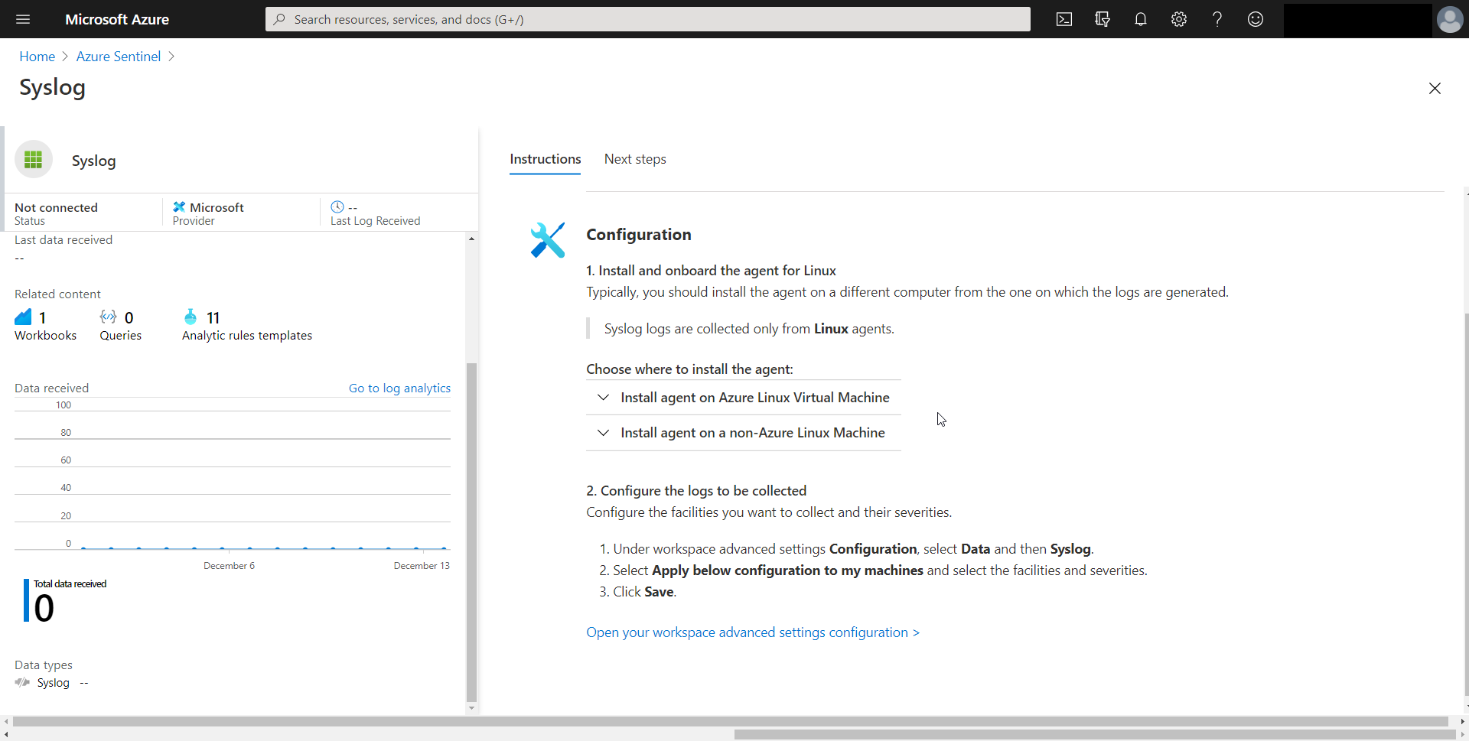
Collect data from Linux-based sources using syslog
The Syslog connector has two deployment options: Azure Linux Virtual Machine and agent on a non-Azure Linux Machine. Azure Linux VM is a simple connect button.
Notes:
To connect Azure based linux VM – it is a simple connect button

Slide 41
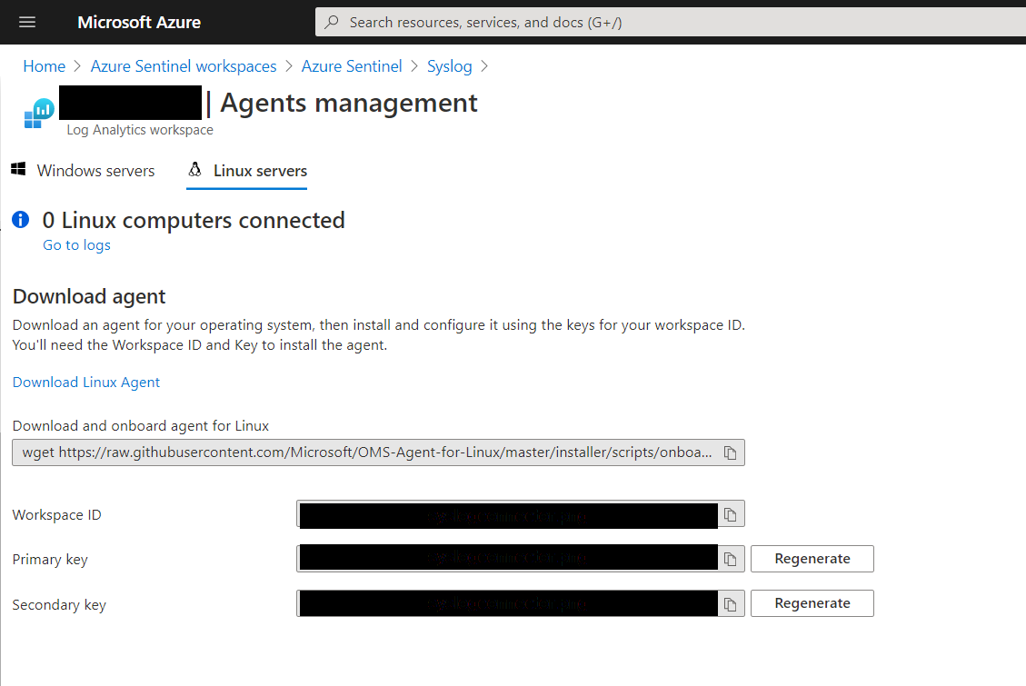
Connect non-Azure Linux Hosts
When connecting non-Azure Linux hosts, you need to manually install the client agent.
Notes:
More steps involved for non-azure. Need to manually install the agent.

Slide 42
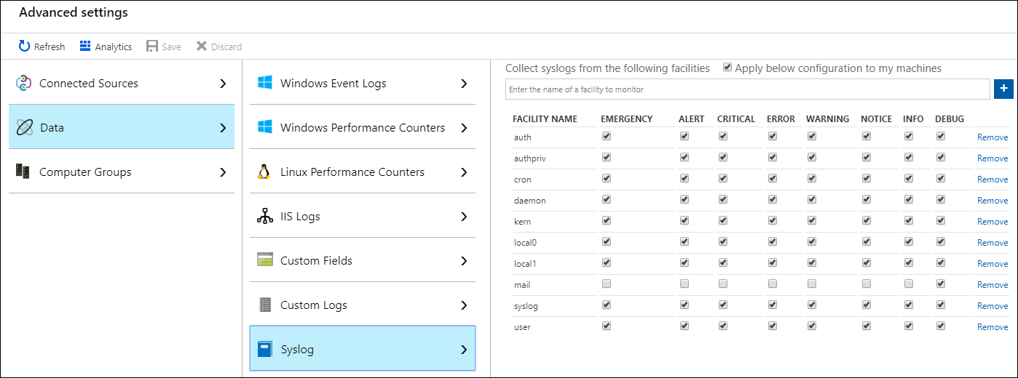
Configure the log analytics agent
The Log Analytics agent for Linux will only collect events with the facilities and severities that are specified in its configuration.
Notes:
This is performed in the Log Analytics workspace. There is a new direct UI location.

Slide 43
Parse syslog data with KQL
// save as a function named: MyParser
Syslog
| where ProcessName contains "squid"
| extend URL = extract("(([A-Z]+ [a-z]{4,5}:\\/\\/)|[A-Z]+ )([^ :]*)",3,SyslogMessage),
SourceIP = extract("([0-9]+ )(([0-9]{1,3})\\.([0-9]{1,3})\\.([0-9]{1,3})\\.([0-9]{1,3}))",2,SyslogMessage),
User = extract("(CONNECT |GET )([^ ]* )([^ ]+)",3,SyslogMessage),
RemotePort = extract("(CONNECT |GET )([^ ]*)(:)([0-9]*)",4,SyslogMessage),
Domain = extract("(([A-Z]+ [a-z]{4,5}:\\/\\/)|[A-Z]+ )([^ :\\/]*)",3,SyslogMessage)
// use the function/parser
MyParser
Notes:
The Syslog collector writes log data to the Syslog table. One difference from the CEF Collector is that the message's data is stored in a string field named SyslogMessage. The Common Event Format (CEF) Connector writes to the CommonSecurityLog with the fields already parsed. For Syslog, you will need to parse fields on every query that uses the Sysmon table or write a Parser. A Parser is a KQL Function that is a query saved as a function and then referenced with the function name. The reference to the function name is like accessing any other table. By creating parses, you only need to write the SyslogMessage parsing once.
In the Logs window, create a query, select the Save button, and select Function from the drop-down. Then specify function name and alias. In this case, if we create the Function named MyParser, I then can access the table using the name MyParser.
Instructor demonstration:
Deploy Syslog Connector
Configure facility
Create a parser

Slide 44
Section break

Slide 45
Lesson 7: Connect threat indicators to Azure Sentinel

Slide 46
Lesson introduction
After this lesson, you will be able to:
Configure the TAXII connector in Azure Sentinel
Configure the Threat Intelligence Platform connector in Azure Sentinel
View threat indicators in Azure Sentinel

Slide 47
Plan for threat intelligence connectors
Indicator Uses Threat Intelligence Connectors
Generate alerts and incidents based on matches of log events from your threat indicators.
Threat intelligence - TAXII
Workbooks provide summarized information about the threat indicators
Threat Intelligence Platforms
Hunting queries allow security investigators to use threat indicators
Notebooks can use threat indicators when you investigate anomalies and hunt for malicious behaviors.

Slide 48
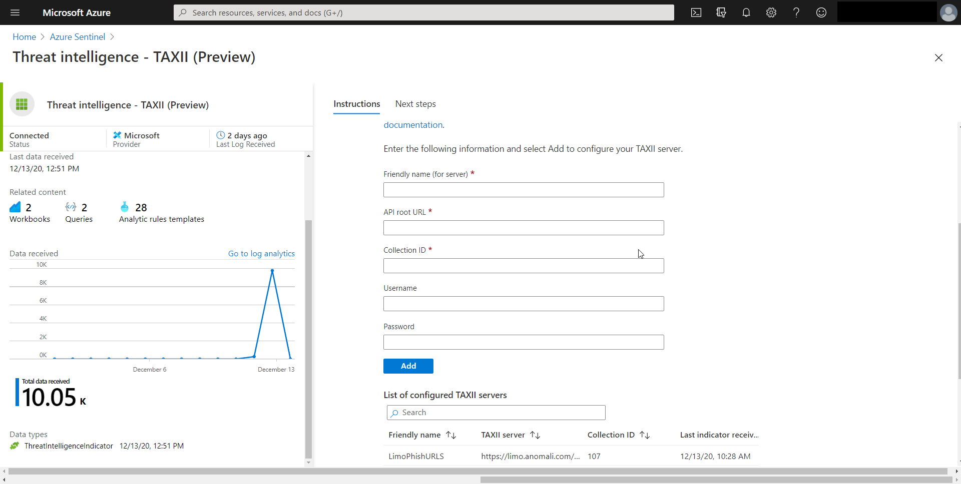
Connect the threat intelligence TAXII connector
Azure Sentinel integrates with TAXII 2.0 and 2.1 data sources to enable monitoring, alerting, and hunting using your threat intelligence.

Slide 49
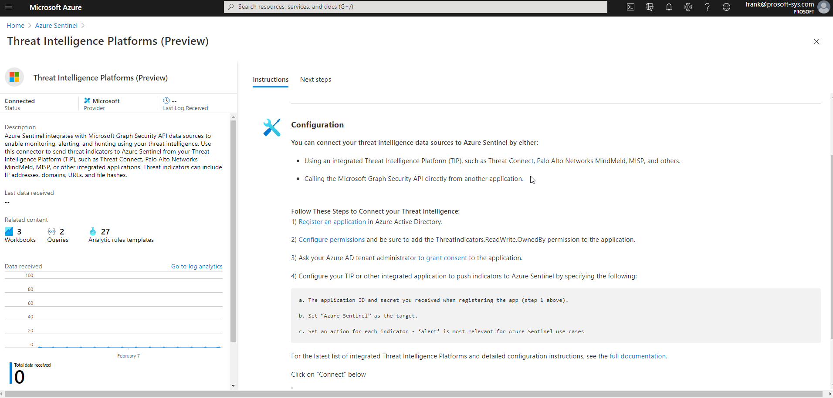
Connect the threat intelligence platforms connector
Azure Sentinel integrates with Microsoft Graph Security API data sources to enable monitoring, alerting, and hunting using your threat intelligence. Use this connector to send threat indicators to Azure Sentinel from your Threat Intelligence Platform (TIP)

Slide 50
View your threat indicators
ThreatIntelligenceIndicator
Notes:
The indicators will also be available in the Threat intelligence blade
Instructor demonstration:
Connect the TAXII connector
View results in the Log window

Slide 51
Section break

Slide 52
Knowledge check
Check your knowledge with the module quiz in your course viewer

Slide 53
Lab 01 – Connect logs to Azure Sentinel

Slide 54
Lab Exercises
1
Connect data to Azure Sentinel using data connectors
2
Connect Windows devices to Azure Sentinel using data connectors
3
Connect Linux hosts to Azure Sentinel using data connectors
4
Connect Threat intelligence to Azure Sentinel using data connectors

Slide 55
Closing slide

